Slide 1
Physical Design
F28DM Database Management Systems
Phil Bartie
Based on material from
Alasdair Gray; Monica Farrow
Notes:
Dual projection for this lecture: one screen for the presentation, the other for live SQL coding

Slide 2

Materials released under CC-BY License
You are free to:
Share — copy and redistribute the material in any medium or format
Adapt — remix, transform, and build upon the material for any purpose, even commercially.
The licensor cannot revoke these freedoms as long as you follow the license terms.
Under the following terms:
Attribution — You must give appropriate credit, provide a link to the license, and indicate if changes were made. You may do so in any reasonable manner, but not in any way that suggests the licensor endorses you or your use.

Slide 3
Topics in this Lecture
Physical Database Schema
SQL
Database creation with MySQL
Integrity Constraints
Referential integrity actions

Slide 4
ANSI-SPARC Three Tier Architecture
Application View
Application View
Application View
Application View
Logical Schema
Logical Data Independence
Physical Data Independence
Physical Schema
Database
Notes:
Separation of Logical and physical
Conceptual model, ER model and relational schema are logical level
Now going to look at physical

Slide 5
Database schema
Logical Schema
Physical Schema
Fixed on model: relational
Vendor neutral
Captures relations, attributes, and types
Representation of
Base relations: stored relations (today)
Integrity constraints (today)
File organisation (next lecture)
Indexes (next lecture)
Tailored to specific DBMS: i.e. MySQL, PostgreSQL, SQL Server, Oracle, …

Slide 6
Client/Server Architecture
Clients connect to DBMS server
One server
Many clients
MACS: MySQL 5.6
Server: mysql-server-1
Clients in linux lab:
mysql console app
phpMyAdmin
Guides on
Vision
MySQL website
Encouraged to use mysql console app, you need to understand the commands.
https://docs.oracle.com/cd/E11882_01/server.112/e40540/img/cncpt083.gif

Slide 7
SQL: Structured Query Language
Standard relational query language
Developed by IBM
Static, strong typing
Data Definition Language (DDL):
Define schema
Define constraints
Drop relations and constraints
Data Control Language (DCL):
Grant privileges
Revoke privileges
Data Manipulation Language (DML):
Insert data
Retrieve data
Update/modify data
Delete data
Transaction Control Language (TCL):
Commit
Rollback
Notes:
Consists of 4 sub-languages

Slide 8
SQL: Standard?
SQL-86: First ANSI standard
SQL-89: Minor revision
SQL-92 (SQL2): Major revision (ISO 9075)
SQL:1999 (SQL3): Extension
Recursive queries
Regular expressions
Custom domains
SQL:2003: XML related features
SQL:2006: Refines XML features
SQL:2008: Minor revision, introduces TRUNCATE statement
SQL:2011: Enhances Windowing Functions
SQL: 2016: Adds row pattern matching, polymorphic table functions, JSON
Notes:
Interoperability is a major challenge
Can’t simply plug schema from one RDBMS into another

Slide 9
SQL Interoperability Problem
RDBMS support a flavour of SQL-92
Different variants!
Custom extensions!
Vendors competing
Functionality
Ease of use
Vendors want lock-in
Difficult to move between DBMS
http://www.pelitawijaya.com/produk-image/travel-universal-adapter.jpg

Slide 10
SQL Syntax
Case insensitive
Conventions
SQL commands: UPPERCASE
Table names: PascalCase -- or lowercase with underscores (lower snake_case)
Column names: camelCase-- or lower snake_case
MySQL table names
Case insensitive on Windows
Case sensitive on Linux/Unix/Mac OS X
Tables are stored in files. Case sensitivity comes from OS file system
MACS database server is running Linux
→ table names are case sensitive!
Notes:
Naming conventions for tables + columns will depend on the RDBMS being used.
Postgresql you are better to use lower snake_case for everything – saves having to add ” inverted commas” around table names etc which is harder to type and prone to making errors.

Slide 11
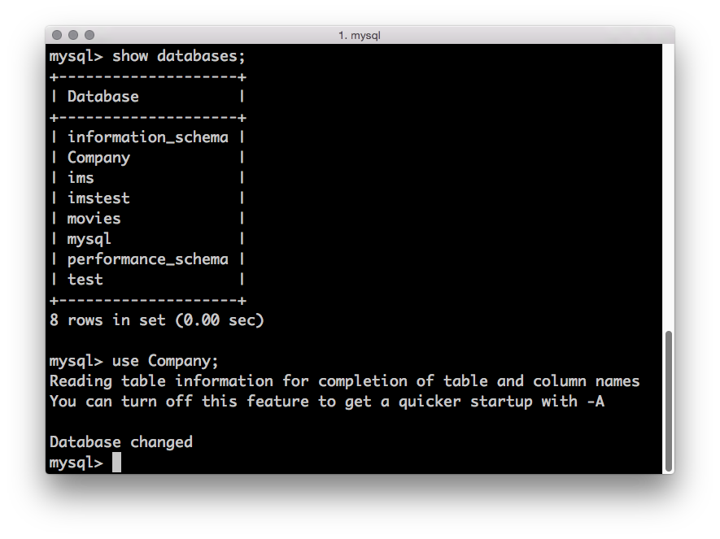
What databases are in my DBMS?
List available databases (restricted by permissions)
> show databases;
Change active database
Loads schema
Enables autocomplete
> use Company;
Only necessary if you start MySQL without declaring the database to use.

Slide 12
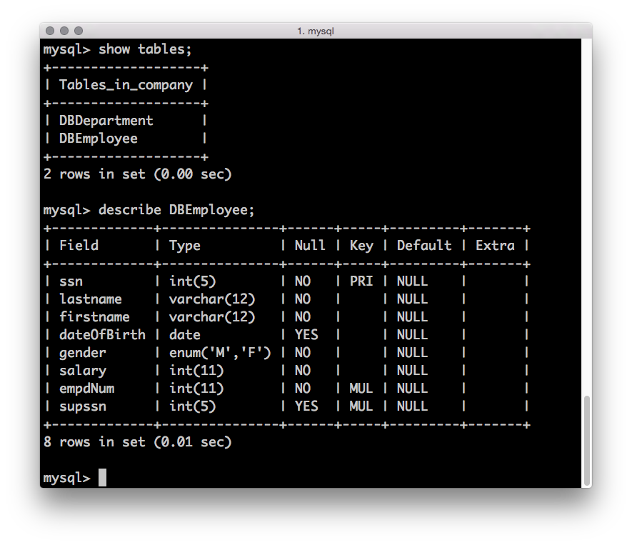
What tables are in my DB?
List available tables in database (restricted by permissions)
> show tables;
Show schema for a specific table http://dev.mysql.com/doc/refman/5.6/en/show-columns.html
Field: column names
Type: data type
Null: are nulls allowed?
Key: [PRI|UNI|MUL]
Default: value
Extra: auto increment
> describe DBEmployee;
Notes:
If more than one of the Key values applies to a given column of a table, Key displays the one with the highest priority, in the order PRI, UNI, MUL.

Slide 13
SQL Data Definition Language
CREATE TABLE:
Defines the schema of a relation in the DBMS catalog
http://dev.mysql.com/doc/refman/5.6/en/create-table.html
ALTER TABLE:
Updates the schema of a relation in DBMS catalog
[ADD|DROP] a [COLUMN|CONSTRAINT|KEY]
RENAME table
http://dev.mysql.com/doc/refman/5.6/en/alter-table.html
DROP TABLE:
Removes relation from DBMS catalog
http://dev.mysql.com/doc/refman/5.6/en/drop-table.html

Slide 14
MySQL Example: CREATE Employee
CREATE TABLE DBEmployee ( ssn INT(5) PRIMARY KEY , lastname VARCHAR(12) NOT NULL, firstname VARCHAR(12) NOT NULL, dateOfBirth DATE, gender ENUM ('M','F') NOT NULL, salary INT(11) NOT NULL, empdNum INT(11) NOT NULL, supssn INT(5), CONSTRAINT fk_empsup FOREIGN KEY (supssn) REFERENCES DBEmployee (ssn), CONSTRAINT fk_empdep FOREIGN KEY (empdNum) REFERENCES DBDepartment (dNum) ) ENGINE=INNODB;
Always use INNODB engine
Notes:
Assumes no table DBEmployee
Uses MySQL data types: note use of VARCHAR rather than CHAR (storage and retrieval)
Primary key defined on attribute (can only be done for single attribute primary keys)
Foreign key references assume dept table exsits, types have to be the same or get errno150
InnoDB only engine that supports transactions and foreign keys (other engines are from early versions of MySQL)

Slide 15
Candidate Keys
Set of attributes that uniquely define a tuple
Single attribute declaration
dName varchar(15) UNIQUE
Multi-attribute declaration
col1 …, col2 …, UNIQUE KEY (col1,col2)
Notes:
PRIMARY KEY ensures uniqueness

Slide 16
Primary Key
One candidate key distinguished as Primary Key
Single attribute declaration
ssn INT(5) PRIMARY KEY
Multi-attribute declaration
projPNum int(11), dLineDate date, PRIMARY KEY (projPNum,dLineDate)
Notes:
PRIMARY KEY ensures uniqueness

Slide 17
Foreign Key
Column type definition must match referenced table’s column type definition
References between relations
… empdNum INT(11) NOT NULL, … CONSTRAINT fk_empdep FOREIGN KEY (empdNum) REFERENCES DBDepartment (dNum)
Constraint name is optional, but improves error messages
Referenced table must already exist. Can reference same table.
Use ALTER TABLE to add constraints between pairs of tables.

Slide 18
ALTER TABLE Examples
Columns can be added
each existing row gets a value NULL in the new field
ALTER TABLE Employee ADD (title VARCHAR(4));
Columns can be altered (replaced)
now salary can be Null
ALTER TABLE Employee MODIFY salary INT (11) default NULL;

Slide 19
Integrity Constraints
Integrity Constraints (IC): set of rules enforced by DBMS
Domain constraints: Data type
Entity constraints: Primary Key
Referential constraints: Foreign Key
Custom constrains: Application/Enterprise specific rules
Declared through
Table creation: CREATE TABLE
Table updates: ALTER TABLE
Limits permitted values

Slide 20
IC: Domain Constraint
Ensures validity of entries for a given column
Only permits values for the specified domain
Declared during table creation
http://dev.mysql.com/doc/refman/5.6/en/data-types.html
Examples (not exhaustive):
Data type | Valid values | Invalid values
INT(5) | 12345, -12345 | 123456, p1234
INT(5) UNSIGNED | 1, 12345 | -12345, p1234
Date | 2016-04-28 | 2015-02-29, 20160428
ENUM(‘small’,’large’) | ’small’, ‘large’ | Any other value, e.g. ‘smal’, 2312, etc.

Slide 21
IC: Entity Constraint
Entity constraint ensures two properties:
Primary key for a row is unique
Two rows cannot have the same primary key value
No component of a primary key can be null
First property ensures uniqueness
Second property ensures meaning

Slide 22
IC: Entity Constraint
Entity constraint ensures two properties:
Primary key for a row is unique
Two rows cannot have the same primary key value
No component of a primary key can be null
Which rows violate this constraint?
ProjectDeadline
projectNumber | deadlineDate | deadlineType
p102192 | 2016-01-31 | Interim
p827392 | 2016-04-28 | Bid
p102192 | null | Final
null | null | Interim
p827392 | 2016-04-28 | Final
ProjectDeadline
projectNumber | deadlineDate | deadlineType
p102192 | 2016-01-31 | Interim
p827392 | 2016-04-28 | Bid
p102192 | null | Final
null | null | Interim
p827392 | 2016-04-28 | Final
Notes:
Animation on slide reveals answer (hidden below table)
Which rows violate constraint?
Row 1 is fine
Row 2 and 5 violate property 1
Rows 3 & 4 violate property 2

Slide 23
IC: Referential Constraint
Foreign key value must be in one of two states:
References a primary key value of referenced table
Set to null
Assumes column is permitted to be null
Which row(s) violate the referential constraint?
Employee
ssn | surname | dNumber
837248 | Smith | 1
626193 | Jones | Null
263819 | McLeod | 2
839281 | Adams | 3
Employee
ssn | surname | dNumber
837248 | Smith | 1
626193 | Jones | Null
263819 | McLeod | 2
839281 | Adams | 3
Department
dNumber | dName
1 | HR
2 | Finance
Notes:
Row 839281 violates the constraint

Slide 24
Applying Referential Integrity
 | ON DELETE | ON UPDATE
CASCADE | Delete referencing records | Update referencing records
RESTRICT | NO ACTION (no distinction in MySQL) (NO ACTION default in MySQL) | Do nothing (Prevents both records being deleted) | Do nothing (Prevents both records being updated)
SET NULL | Set the foreign key value in referencing records to Null | Set the foreign key value in referencing records to Null
Set default (not MySQL) | Set the foreign key value in referencing records to a default value | Set the foreign key value in referencing records to a default value
http://dev.mysql.com/doc/refman/5.6/en/create-table-foreign-keys.html
Notes:
Difference between restrict and no action is when the constraints are checked: restrict checks before carrying out operation, no action after. Can affect whether the operation is permitted

Slide 25
Referential Integrity Examples
What is the effect of the following constraint on the Employee relation when a supervisor is deleted?
FOREIGN KEY (supervisor) REFERENCES Employee (ssn) ON DELETE SET NULL
When a supervisor is deleted, the employees that are supervised by them have their supervisor column set to Null.
What is the effect of the following constraint on the Location relation when a department is deleted?
FOREIGN KEY (dNum) REFERENCES Department (dNum) ON DELETE CASCADE
The locations for the department stored in the Location table are deleted.
Notes:
Animation changes the font colour of the answers (Answers will be published on Vision)
Employee supervisor columns are set to NULL on delete
Location deleted when the department is deleted

Slide 26
IC: Custom Constraints
Constraints not covered by previous categories
Focus on capturing enterprise rules
Attribute is not allowed to be NULL
Use NOT NULL in CREATE TABLE statement
Enforce participation constraint
empdNum INT(11) NOT NULL
Check Constraint: enforce some condition
CONSTRAINT chk_shoe_size CHECK (shoeSize >= 1 && shoeSize <= 13)
Other examples (beyond scope of this course)
Trigger rules
Stored procedures
Parsed but not enforced in MySQL
Notes:
Triggers are useful to automate some process (stored procedure) on data insert, update, delete.
For example automatically adding a timestamp to an insert as another timestamp column…..
{click example on next slide}

Slide 27
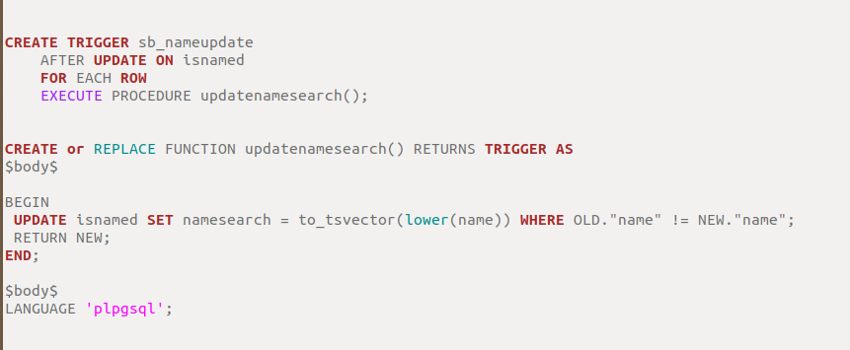
Trigger Example for Postgresql
Notes:
This example of a trigger in postgresql will call the stored proc updatenamesearch() when an entry is updated in the isnamed entity….. What it does is generate a ts_vector for full text searching and store that into the namesearch attribute. It could be used on INSERT to, or DELETE – eg to move a copy of the data to a log table when an item is deleted.
Or a trigger could be used to take an input coordinate given as a pair of latitude and a longitude values and then generate a single geometry type to store as an attribute (e.g. point).

Slide 28
Enforcing Integrity Constraints
Options when integrity constraints violated:
Permit update: ignore constraint
Refuse update: enforce constraint
Compensate: e.g. insert null or default value, follow referential integrity condition
Check what DBMS does
MySQL does not enforce CHECK
MySQL InnoDB engine enforces foreign key

Slide 29
SQL Data Manipulation Language
INSERT: Add data to the database
http://dev.mysql.com/doc/refman/5.6/en/insert.html
May be over multiple tables via a view
SELECT: Retrieve data according to conditions
http://dev.mysql.com/doc/refman/5.6/en/select.html
Covered in detail next week
UPDATE: Amend values in the database
http://dev.mysql.com/doc/refman/5.6/en/update.html
DELETE: Remove values from a relation
http://dev.mysql.com/doc/refman/5.6/en/delete.html
Does not remove the relation
May specify a condition

Slide 30
INSERT Example
Add an entire tuple:
Order of values must be the same as schema definition
INSERT INTO DBDeadline VALUES (3, '2013-01-25', 'Bid');
Add partial data
Declare columns and ordering
Can include all columns with custom ordering
Must include primary key
Omitted values will be set to default or Null
INSERT INTO DBDeadline (deadline,pName) VALUES ('2013-02-21',4);
Inefficient to insert data row by row

Slide 31
Bulk Loading/Data Dump
Bulk Loading: read data from files
http://dev.mysql.com/doc/refman/5.6/en/load-data.html
Can be used for schema creation
Should include drop statements
LOAD DATA LOCAL INFILE '/u1/staff/ajg33/MySQL/Bank/AccountData' REPLACE INTO TABLE BankAccount Fields terminated by ',';
Data dump: export data to be reloaded (backup)
http://dev.mysql.com/doc/refman/5.6/en/mysqldump.html
Separate application

Slide 32
SQL: Data Control Language
Covered in more detail in a later lecture
GRANT
Allow a user some privilege on a database, table, column, …
http://dev.mysql.com/doc/refman/5.6/en/grant.html
REVOKE
Remove a privilege from a user
http://dev.mysql.com/doc/refman/5.6/en/revoke.html

Slide 33
SQL: Transaction Control Language
These are covered in a future lecture
http://dev.mysql.com/doc/refman/5.6/en/commit.html
BEGIN
Start a transaction
COMMIT
Complete a transaction
ROLLBACK
Undo the work since last commit

Slide 34
Summary
Separation of logical and physical schema
Data Definition Language statements
Integrity Constraints
Entity: Primary key
Referential: Foreign key
Domain: Data type
Enterprise: Other
On update/delete
CASCADE
NO ACTION
SET NULL
SET DEFAULT

